Slide 1
Foundations
This chapter lays down the fundamental ideas and choices on which our
approach is based. First, it identifies the needs of architects in the design,
communication, realisation, and change of enterprise architectures. It then
describes the central role of architecture models in our approach, the use of
models in communication, the relationship between models and their pres
entation, and the formalisation of the meaning (i.e., semantics) of models.

Slide 2
Foundations
Getting to Grips with Architectural Complexity
Describing Enterprise Architectures
Pictures, Models, and Semantics
Summary

Slide 3
1. Getting to Grips with Architectural Complexity
Compositionality
Integration of Architectural Domains

Slide 4
1.1. Compositionality
Compositionality is a central role in the architectural approach.
Compositionality also plays a role when varying viewpoints on a system are defined.

Slide 5
1.2. Integration of Architectural Domains
Some integration problems can be easily solved: for example, by using an existing standard; others are intrinsic to the architectural approach and cannot be ‘solved’ in the usual sense.
These hard cases are intrinsic to the complexity of architecture, and removing the problem would also remove the notion of architecture itself. We cannot get rid of the integration problems; we can only develop concepts and tools to make it easier to deal with these issues

Slide 6
2. Describing Enterprise Architecture
Observing the Universe
Concerns
Observing Domains
Views and Viewpoints
Ways of Working
Enterprise Architecture Models

Slide 7
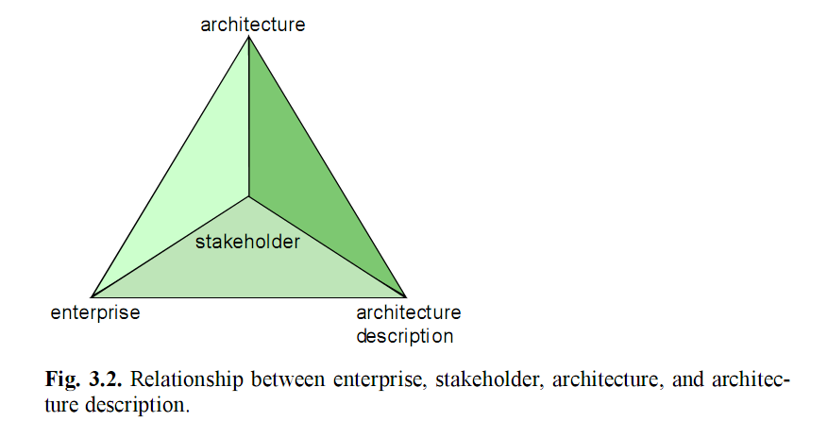
2.1. Observing the Universe

Slide 8
2.2. Concerns
So in conceiving a part of the enterprise, stakeholders will be influenced by their particular interest in the observed enterprise, i.e., their concerns. Note that stakeholders, as well as their concerns, may be regarded at an aggregated as well as at an individual level.
For example, a single business manager conceiving an information system is a stakeholder. The collective business management, however, can also be seen as a stakeholder of the information system.

Slide 9
2.3. Observing Domains
Domain: any subset of a conception (being a set of elements) of the universe that is conceived of as being
Model: a purposely abstracted and unambiguous conception of a domain. some ‘part’ or ‘aspect’ of the universe.
Modelling: the act of purposely abstracting a model from (what is conceived to be) a part of the universe.

Slide 10
2.4. Views and Viewpoints
View: a representation of a system from the perspective of a related set of concerns.
Viewpoint: a specification of the conventions for constructing and using a view; a pattern or template from which to develop individual views by establishing the purposes and audience for a view and the techniques for its creation and analysis.

Slide 11
2.5. Ways Of Working
Creating and using architecture models typically involves several related ‘ways of working’ (Wijers and Heijes 1990):
A way of thinking
A way of modelling
A way of communicating
A way of working
A way of supporting
A way of using

Slide 12
2.6. Enterprise Architecture Models
The importance of the set of concepts which are used to describe an architecture is acknowledged in the frequent use of ‘ontology’ within modelling.

Slide 13
3. Pictures, Models, and Semantics
Symbolic and Semantic Models
Symbolic Models
Semantic Models
UML vs. ArchiMate

Slide 14
3.1. Symbolic and Semantic Models
A symbolic model expresses properties of architectures of systems by means of symbols that refer to reality.
A semantic model is an interpretation of a symbolic model, expressing the meaning of the symbols in that model.

Slide 15
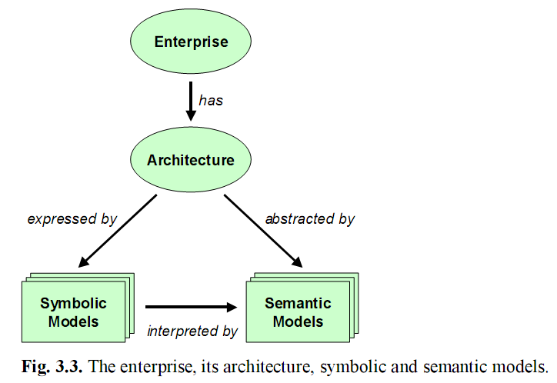
3.1. Symbolic and Semantic Models
There are various ways in which we can visualise the relation between the four central concepts of enterprise, architecture, symbolic model, and semantic model.

Slide 16
3.1. Symbolic and Semantic Models
There are two kinds of abstraction we use in creating a model of reality.
The first is abstracting from (properties of) the precise entity in reality to which a concept refers.
The second kind is abstraction from differences between entities in reality by grouping them into a single concept.

Slide 17
3.2. Symbolic Models
A symbolic model is the formalisation of one or more aspects of the architecture of a concrete system.
A symbolic model is expressed using a description language, a representation of the model that is often confused with its interpretation.

Slide 18
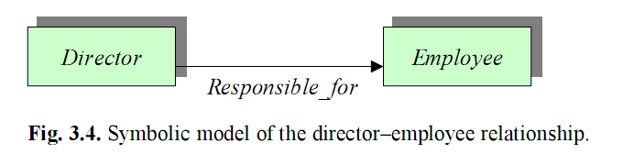
3.2. Symbolic Models
The core of every symbolic model is its signature.

Slide 19
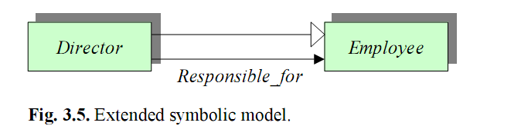
3.2. Symbolic Models
A signature thus provides a conceptual glossary in whose terms everything else in the symbolic model must be described, similar to an English dictionary for the English language.
A signature comprises information to capture certain aspects of the ontology of an architecture.

Slide 20
3.3. Semantic Models
The formalised meaning of a symbolic model is given by a semantic model, an interpretation of the symbolic model.
A semantic model usually assumes the existence of some mathematical objects (sets, for example),used to represent the basic elements of a symbolic model.
Operations and relations of a symbolic model are mapped to usually better understood operations and relations amongst the mathematical objects.

Slide 21

3.3. Semantic Models
we see the formal semantics of a symbolic model as a concrete collection of mathematical objects interpreting a system according to a specific architecture description.

Slide 22
3.4. UML vs. ArchiMate
The ArchiMate approach can be contrasted with the original approach in UML.
People who used the models could develop semantics for them, but a general semantics was not supplied. This approach also stemmed from the origins of UML as a combination of three existing notations that did not have formal semantics.

Slide 23
4. Summary
Within this framework, a distinction is made between the content of a view and its visualisation, and a distinction is also made between a symbolic model, which refers to the enterprise architecture, and a semantic model as an abstraction from the architecture and which interprets the symbolic model. The core of every symbolic model is its signature, which categorises the entities of the symbolic model.

